Slide 1

The Socio−Economic Study for Lidl Slovenská republika, s.r.o.
August 2025

Slide 2
Contents
In the introduction to the Socio-Economic Study, we explain the basic concept thereof; in the Economic Value Generated in the Slovak Republic section, we discuss in detail all types of the analyzed economic impacts of the Lidl’s operations in the Slovak economy. The Additional Economic Effects section contains a detailed calculation of the induced economic value. In the final methodological section, we inform the reader about methodological changes.
U
01
02
03
04
05
06
07
08
Introduction
Methodology
Economic Value Generated in the Slovak Republic
Additional Economic Effects

Slide 3

Introduction
Lidl is publishing its fourth edition of its Socio-Economic Study in 2025. In the 2024 financial year, Lidl distributed the real economic value to 77 Slovak districts and directed to regions outside Bratislava the economic value higher by EUR 40 million than in the previous year, 2023.
Assessing Socio−Economic Impact
There are several initiatives that are dedicated to expressing the added value in the economy, which is created by various multiplier effects. In the introduction of each new edition of the Socio-Economic Study, we compare our results with other approaches. For this year's comparison, we have chosen the Multifactor Productivity − MFP* (also referred to as “TFP“ Total Factor Productivity) as the first indicator. This is an analysis of the added value that can be attributed to factors other than increases in the labor and capital inputs, such as to the efficiency of their use. The effects of MFP are quantified using the OECD's STAN structural statistics, which are also available for the retail sector in Slovakia. We estimated the added value of MFP for the Slovak retail sector by applying the following parameters obtained from the OECD database (we compared the years 2022/21, as there was no increase in hours worked between 2023/2022, which would complicate the calculation):
Annual output growth
Labor contribution
Capital contribution
Value added (MFP)
We recorded a year-on-year output growth of 2022/2021 in the Slovak retail sector of 13%. A part of this growth is attributed to capital investments (“Gross Capital Stock Growth”) and a part to the increase in hours worked (“Employees – Hours”). The calculation also estimates the share of labor and capital in costs; we chose the ratios of 0.7 vs. 0.3** for the retail sector. In the period 2022/2021, the number of hours worked increased by 4.5% and capital investments by 18%. After recalculation, the share of labor and capital in sectoral growth comes out at 64%. The remaining 36% is represented by other factors that are also growth multipliers, such as the use of know-how, innovation and other tools to increase the efficiency of the use of labor and capital. In other words, 36 cents of every Euro of growth in Slovak retail can be attributed to added value.
In its publication "Money Trail", the New Economy Foundation (NEF) think tank analyzes situations, where cash flows remain in the region, and evaluates the associated benefits. According to NEF, a higher share of economic value re-invested in the local economy means a higher multiplier effect, as more income is generated for local residents. More income retained at the local or national level means more jobs, higher wages, and more tax revenues for the state. All of these benefits can lead to a higher standard of living. For the fourth year in a row, we have been emphasizing in the Socio-Economic Study a mapping of the economic value flows to the Slovak regions, where Lidl workers, Slovak entrepreneurs, the third sector and local governments are the beneficiaries.
In July 2023, the World Bank published the study “Is the Magic Happening?“ (document No. 10529), where it analyzes 23 studies of the multiplier effect, and states that estimating the multiplier effects from the flow of economic value (generating additional value from each dollar “paid”) represents a new way to assess the impact on communities.
* Regional productivity growth in the EU: An assessment of recent developments, 2023
** The retail sector (ISIC-Rev.4) has the second highest number of workers in Slovakia according to ILO Statistics; therefore, we have chosen a higher share of labor.

Slide 4


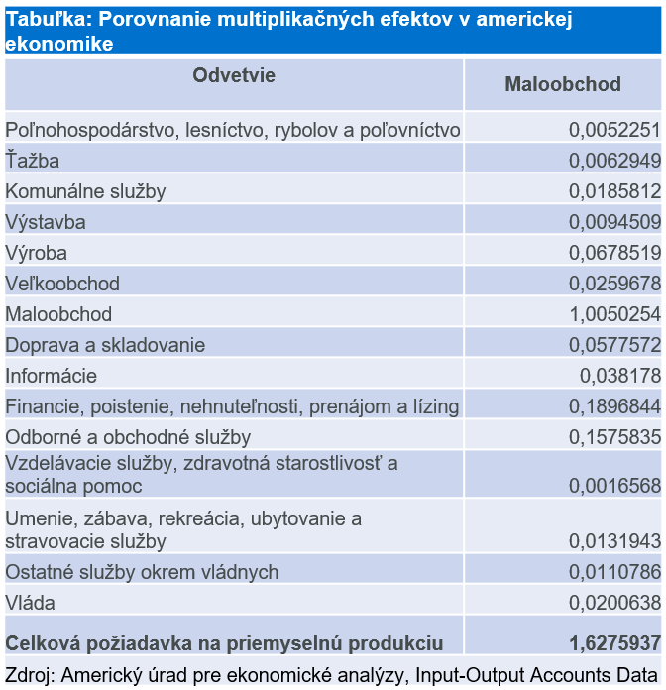
Introduction (continued)
The World Bank study focuses on cash transfers from the development programs to local economies in the less developed countries and tracks the multiplier effects on the target, as well as on other communities. The effects vary depending on the program and the country. The study offers several multipliers at the level of 1.5 (1 dollar generates additional 50 cents – Livelihood Empowerment Against Poverty, Local Income Multiplier in Ghana).
The results of the Socio-Economic Study are more conveniently compared with the multiplier for the retail sector. The US Bureau of Economic Analysis presents the “Input-Output Accounts Data“ statistics, which is an expression of the multiplier effects in the US economy. For 2023, the figure of 1.62 is available for retail. The figure can be interpreted in two ways:
An increase in activity corresponding to the economic value of one dollar will increase the value of support services by 62 cents (one dollar generates 62 cents).
A one dollar increase in the retail sector will cause an increase of 1 dollar 62 cents in the economy as a whole.
The table provides an overview of the sectors of the economy that are affected by retail.
The overview in the table is a depiction of the relationships between sectors in the US economy.
In the Socio-Economic Study, Lidl’s multiplier is composed not only of partial effects of various sectors of the economy (Lidl’s suppliers), but similarly, as follows from the content of the World Bank study, the Lidl’s social programs (gifts, employee benefits) have also been taken into account.
The comparisons referred to in the introductory chapter can be summarized as follows:
MFP in Slovakia: The added value from 1 EUR of growth in retail is 36 cents.
USA: Every 1 dollar of increase in retail activity has the potential to generate additional 62 cents.
The induced economic value for Lidl for 2021, 2022 and 2023 was estimated at 57 to 58 cents.
A difference between MFP in Slovakia and in the USA means that, in Slovakia, we need more capital investments and hours worked to achieve the same multiplier effect. The same also applies when comparing the Slovak multiplier effect with the Lidl effect:
In the Slovak economy, it is necessary to spend more capital and working time to achieve the same effect as Lidl achieves – Lidl is more efficient.
Lidl builds the functional business relationships across sectors of the Slovak economy in order to be able to secure its activities. These connections can be characterized by higher interconnectedness (involving a larger number of actors in the value chain), higher added value created (e.g. acquisition of additional skills) or higher efficiency compared to cross-sectoral relationships in the Slovak economy.

Slide 5

01 Methodology
Categorisation of Economic Impacts
The method of categorizing the value flows in the Socio-Economic Study is based on the Stakeholder Capitalism Metrics and GRI 201-1 methodologies. The application of this approach and the division of categories between the direct and indirect economic impact was described in the methodological sections of the previous editions of the Socio-Economic Studies; no changes have been made in these areas compared to the previous periods. The methodological chapters are available on pages 5 or 6 of previous Studies published on the website www.spolocenskazodpovednost.sk. We analyze the methodologies discussed therein in more detail.
Leontiev Production Function
The economic value generated was estimated using the Leontiev production function. A more detailed description of this procedure is available in the methodological sections of previous editions of the Socio-Economic Study. The production function is also referred to as an “input-output model”, which quantifies the amount of inputs needed for a given amount of outputs or vice versa. Inputs and outputs can be as follows:
Cross-sectoral inputs:
Products or services that one sector purchases from another to produce its own output
Primary inputs:
Labor (time worked, wages)
Capital (machinery, buildings)
Natural resources (energy, water, raw materials)
Cross-sectoral outputs:
Products or services that one sector provides to other sectors as inputs
Final outputs:
Products and services
The above-described methodology is used to calculate the multiplier effects in the introductory table of the US Bureau of Economic Analysis, and to estimate the effect of economic value induced by Lidl - the induced value of 57 to 58 cents by Lidl is thus methodologically completely comparable to the value of 62 cents in the same sector in the USA. This comparison does not serve as an ambition to achieve an identical value, but to compare as to what extent the results achieved are similar (there may be differences in the efficiency, technological procedures, etc. in both countries). The method of calculating MFP in Slovakia is also a calculation of a multiplication factor, but the calculation procedures are not identical.
A comparison of the estimated multipliers of 36 cents (retail in Slovakia) and 57 to 58 cents (the value induced by Lidl in the amount of 57 to 58 cents) shows that Lidl has a higher added value than retail in Slovakia in general.
Business Case Catalog
When tracking cost items, we primarily used records that were defined as a specific account and category from the Business Case Catalog valid for the 2024 business year.
Least Developed Districts (LDD)
To determine the LDD, we used the list published on 17/04/2025 prepared pursuant to the Act 336/2015 Coll. on the Support of the Least Developed Districts, and on amendments to certain acts. The Snina District was removed from the list of LDD in 2024; we do not include it in the current comparisons for 2024.
Period Monitored
The data collected in the Study are time-differentiated and fall into the period of the 2024 business year lasting from March 1, 2024 to February 28, 2025.

Slide 6

01 Methodology (continued)
Methodological Differences Compared to 2023
The increase in the real economic value distributed to the Bratislava region from the level of 386 million in 2023 to the level of 807 million in 2024 was due to the following methodological changes:
For taxes other than local taxes, we did not report a specific seat in the previous period, only the state of the beneficiary. We have currently assigned the seat of Bratislava to all tax items (EUR 294 million).
For suppliers with more branches in Slovakia (including Bratislava), we directed the flow to the capital city in 2024 (in the previous period, a specific seat was not assigned).
The methodological change does not affect the monitoring and comparison of the distribution of value to regions.
Beneficiaries
In the Socio-Economic Study, we analyze the following basic types of stakeholders, who benefit from the economic value that Lidl distributes to Slovakia: the private sector, the state, workers, cities, and the third sector.
These beneficiaries are recipients of the real economic value from Lidl, or benefit from multiplier effects (so-called induced economic value) that occur both in business and in the development projects.
In business, these are payments for services and estimates of additional effects induced in various sectors of the economy. Lidl’s supplier structure is very diverse (especially due to the supply of services and products for Lidl’s own consumption − services and goods to ensure the daily operations of its own organization), and Lidl’s positive effects are therefore manifested in a wide range and benefit the type of beneficiary that we refer to as the "private sector". For example, these are the following types of stakeholders:
Suppliers of products and services from various sectors (e.g. education, accommodation, etc.)
Pension management companies
Private energy suppliers (ZSE Energia is considered a private sector, as a significant degree of control thereof is held by the German E.ON concern)
For some suppliers, the category of private sector was not applied, but the categories of Cities or State. These are the following cases:
Cities:
Water companies
Heating plants, municipal housing companies
Transport companies
State:
State authorities (for example, training provided by the Financial Directorate of the Slovak Republic)
Selected health facilities
National Highway Company
In the case of projects aimed at developing the quality of life, the State or Cities are in some cases also the beneficiaries of direct payments from Lidl and of the resulting positive effect:
Cities: primary schools founded by them (we also use the “Cities" category for secondary schools, although a Higher Territorial Unit is the founder there).
State: the selected health facilities
In other cases, the third sector is the beneficiary of Lidl’s payments and positive multiplier effects.
Workers are the beneficiaries of direct payments in a form of wages and various expenses for their wellbeing, health check-ups, etc.
The World Bank study summarizes estimates of the multiplier effects of various development projects, and thus confirms the existence of "induced" positive value for communities, the third sector (not only for business). These include, for example, projects aimed at increasing resilience to poverty, supporting employment, or supporting children.

Slide 7

02 Economic Value Generated in the Slovak Republic
The third sector | Workers | Private sector | Cities | State | Total
€1,374,010 | €95,455 690 | €852,646,924 | €2,524,720 | €336,731,250 | €1,288,732,593
Distributed Value
The economic value representing the social benefit (direct and indirect economic impact) for the business year of 2024 exceeded EUR 1.2 billion for the first time. Compared to 2023, there was a further increase in the value for three out of five categories of beneficiaries (Workers, Private sector and Cities). The most significant increase by 22% was recorded by the Private Sector. The total value of positive economic benefits distributed by Lidl increased by 12% compared to 2023.
From the year-on-year comparison of data, we see a continuous increase in the total real economic value distributed by Lidl to the Slovak economy. This increase has been mainly supported by the category of Direct Economic Impact − spending on purchases from Slovak suppliers (but not VAT, which decreased in 2024). The total economic value in 2024 amounted to EUR 1,288,732,593.
Social Services
According to the Amount of the financial contribution for social services for 2024 published by the Ministry of the Interior of the Slovak Republic, the average annual amount of the financial contribution for the provision of residential social services in a social services facility was EUR 5,712 per place in a social services facility. The concept of the Reform of Social Services Financing from December 2024 states the average price of the service** of EUR 16,392 per person/year in a facility for seniors with a year-round residential form.
The table below shows these costs by region. The third column shows the number of jobs that can be created thanks to the real economic value generated by Lidl in a specific region.
According to the SITA report, there are large differences in the availability of social care for seniors. While there are only 42 places per 10,000 inhabitants in the districts of Kežmarok or Sobrance, there are as many as 515 in Medzilaborce. According to the recommended standard for the Reform of Social Services Financing draft, the number of places in facilities for seniors should be in the ratio of 72 places per 10,000 inhabitants.
The districts of Kežmarok (250 missing places), Sobrance (38 missing places) and Bánovce nad Bebravou (115 missing places) are among the districts with the smallest capacity of places for seniors (significantly below the recommended standard).
Lidl’s payments allocated to all these districts can cover the annual costs (cumulatively) of € 520 thousand for financing the total standardized need for places for seniors in the social facilities.
Source: Analysis of the provision of social services in the Slovak Republic, 2024
The topic of accessibility of social services for seniors is mainly a "topic of the future". The estimate of demographic development predicts an aging population for Slovakia.
Region | Expenditures per person/month by region | Number of jobs
Bratislava | €1,713 | 550 th.
Trnava | €1,467 | 82 th.
Nitra | €1,234 | 85 th.
Trenčín | €1,375 | 30 th.
Banská Bystrica | €1,351 | 32 th.
Žilina | €1,400 | 26 th.
Košice | €1,244 | 24 th.
Prešov | €1,262 | 72 th.
Source: Ministerstvo práce, sociálnych vecí a rodiny
Direct economic impact
Indirect economic impact
Total impact
The lower VAT is partly due to the reduced VAT on the selected food products at the beginning of 2025, but mainly due to increased
costs, which increased proportionally more than sales (the difference was approximately EUR 5 million).
** The price of the service is composed of the labor and contract costs, capital expenditures, goods and services, and current transfers.

Slide 8

02 Economic Value Generated in the Slovak Republic (continued)
BA Region | NR Region | TT Region | PO Region | BB Region | TN Region | ZA Region | KE Region
€807 mil. | €118 mil. | €103 mil. | €97 mil. | €56 mil. | €43 mil. | €34 mil. | €30 mil.
Infrastructure Projects
In addition to the new infrastructure projects, reconstructions of the existing infrastructure are also planned in Slovakia in the long term. The table below shows examples of these situations in the selected districts, and the identified financial need for the implementation of the selected investment.
In the Galanta district, this involves the planned reconstruction of the bridge over the railway in Sereď, which has been closed since May 2023 due to an emergency situation, and drivers are therefore dependent on detours. The I/50 road between Prievidza and Nováky has long required reconstruction, for example due to the increased risk of skidding caused by road wear. In Rožňava, Lidl’s contribution to this district would be sufficient in 2024 to reconstruct the roof of the town hall and community center.
Support for Culture
In this part of the Study, we compare the distribution of economic value to districts with the costs of operating theaters under the founding authority of cities and regions. Specifically, the Jozef Gregor Tajovský Theater in Zvolen, the City Theater in Žilina, the Slovak Chamber Theater in Martin and the ACTORES City Theater in Rožňava. In all cases, the real economic value generated in the districts of Martin, Zvolen, and Žilina would cover the costs of the annual operation of these three theaters. The City Theater in Žilina would have its financing covered for 12 years with Lidl’s annual contribution, and the theater in Zvolen for another 6 years. If we consider the amount of 2 million EUR as the average annual cost of operating one city theater (within the founding competence of the city or a higher territorial unit), then the real economic value generated by Lidl specifically for the “City“ type of beneficiary can annually finance a city or regional theater. The following table shows the costs of annual financing of the selected theaters. The data come from the financial reports for the year 2024.
The total costs of operating the theater are also partly financed by income from the sold admission tickets and grants or other state contributions. In the following example, we therefore work only with a contribution from the budget of the city of Rožňava.
The economic value generated by Lidl to the Rožňava district in 2024 would allow financing the annual contribution to the operation of the ACTORES City Theater (paid from the city budget) in the amount of EUR 200 thousand for seven years.
Source: Budget of the city of Rožňava for the year 2024, p. 33
The distribution of value to regions, in the percentage terms, looks as follows:
District | Financial need in millions of EUR
Galanta | 8 mil.
Prievidza | 11 mil.
Rožňava | 0.7 mil.
Source: Media outlets and budget of the city of Rožňava
Theater | Annual cost in EUR
The JGT Theater in Zvolen | 2.3 mil.
Chamber Theater in Martin | 2.7 mil.
City Theater in Žilina | 1.5 mil.
Source: 2024 financial results

Slide 9
02 Economic Value Generated in the Slovak Republic (continued)
Lidl continued to deliver the direct economic value to 77 districts in Slovakia in 2024, including those officially designated as Least Developed Districts (LDD). In seven of these districts, the real economic value delivered by Lidl has continuously increased over the past three years.
Impact of Distributed Value on Districts
The methodology for reporting results at the district level used in the Socio-Economic Study has not changed compared to the previous two editions of the Study. While Lidl distributed the economic value to 69 districts in 2022, there were already 77 of these districts in 2024. Annually, Lidl regularly distributes the largest value to the Kežmarok district – in 2024, it was almost 30 million EUR.
The Kežmarok district is not visualized in the graphs, as the contribution is so high that it would complicate the visualization of other districts. We obtained data on state support from the List of concluded contracts for the provision of regional contributions – we filtered out contracts with effect from 2024. The List is available on the website of the Ministry of Investments, Regional Development and Informatization.
Okres = District
* The increase of 150% is shown in the graph for the District of Sabinov for the period 2024/2023; in reality, this increase was over 500%, but it is not possible to visualize it in the displayed graph.
** The comparison of LDD Districts does not include the District of Medzilaborce, Košice-Surroundings (in the Study, we do not distinguish between the District of Košice and Košice- Surroundings) and the District of Poltár. The comparison does not include the District of Kežmarok, where Lidl’s support in 2024 is at the level of 29 million EUR − this amount would complicate the display of the entire graph.

Slide 10
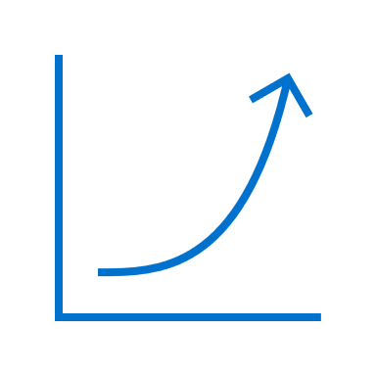

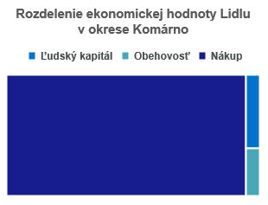
02 Economic Value Generated in the Slovak Republic (continued)
In the Kežmarok district, the value provided by Lidl continuously increased from EUR 16 million in 2021 to EUR 21 million in 2023, up to almost EUR 30 million in 2024. The year 2025 is the period of introducing changes in the LDD methodology, with the aim of replacing the concept of “Least Developed Districts" with the new concept of “Priority Districts". The new categorization of “Priority Districts” will be fully implemented from 2026. In the current edition of the Study (for 2024), we use the original methodology and concepts that represent the current legal status for 2024.
In 7 LDD, an annual increase in the value provided by Lidl was recorded during the four-year period under review.
In 10 LDD, in 2024, the real value distributed by Lidl was higher than the amount of the State contribution to the given district. In the Kežmarok district, the value delivered by Lidl was 37−times higher than the State support. In the districts of Lučenec, Sobrance, Stará Ľubovňa and Trebišov, the value delivered by Lidl was at least 3−times higher than the State contribution.
The Case Study
The „How Do You Live in the Regions?“ analysis by the Institute for Digital and Regional Policies explains the composition of the Regional Development Index, which maps three main areas: Access to public infrastructure and basic services, Demographic status and Socio-economic area. In Socio-Economic Studies, we address topics that fall into these areas, such as Investments in infrastructure, Availability of healthcare, Social services, etc. We relate these “public services” to the costs of providing them and estimate, what part of them could be financed by Lidl payments to regions with a lack of these services. However, in our analyses, we emphasize a specific aspect of the contribution of the functional economic relations to the development of human capital, which is also mentioned in the analysis How Do You Live in the Regions?: “In addition to economic factors, the Least Developed Districts are also troubled by a lack of infrastructure or insufficient development of human capital, which create a vicious circle of backwardness and unattractiveness of these areas for residents.” The analysis also draws attention to shortcomings in the
current definition of LDD, as when districts were analyzed using the Regional Development Index, districts were found that "fell through the net" in the current LDD classification system despite their lower overall level of development. An important finding of the analysis is the gradual decline in the development of southern Slovakia, especially the Komárno district, which, despite its relative proximity to the capital city, lags significantly behind the rest of the region. In 2024, Lidl generated a value of more than 32 million EUR in the Komárno district, making it the fifth largest recipient of economic value generated by Lidl in 2024. The following table is a breakdown of this value by category.
Source: Lidl in Slovakia
The Human Capital category is represented by payments to Lidl employees. The Circulation category includes payments for maintenance of technical equipment carried out by a company located in the district. The purchase represents payments for products produced in the district in the food segment:
Processing of wheat and rye into flour and other products
Growing of fruits and vegetables, production of pasta, ice cream
Winemaking
The above-mentioned areas are those, in which Lidl has co-created the multiplier effect in the Komárno district thanks to the functional economic relations. The Komárno District Development Plan reminds that the endogenous potential of the district in a form of fertile agricultural land has not been sufficiently used. The material and value chains between agricultural production and the processing industry are interrupted; a low level of cooperation between local development actors has been hinder the activation of the development potential of localities.
Lidl can be considered a significant regional actor with a potential to expand the activities of local food and agricultural producers.
3
%
95%
2
%

Slide 11
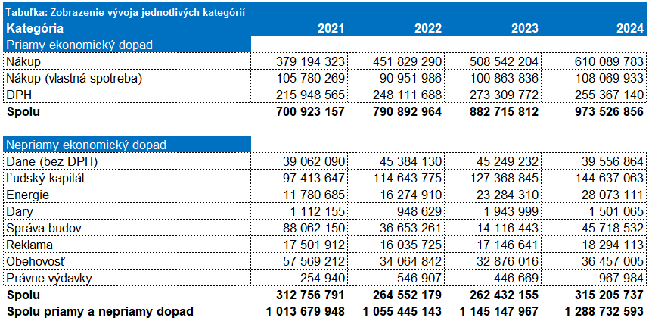
02 Economic Value Generated in Slovakia (continued)
Direct economic value distributed to the Slovak economy, expressed at the national and regional level, creates a positive direct and indirect economic impact.
Direct and Indirect Economic Impact
In the Socio-Economic Study, we distinguish between the direct and indirect economic impact depending on whether the distributed economic value was generated by Lidl’s core activities (purchase and sale to consumers) or by supporting activities (e.g. logistics, maintenance, training, etc.). The breakdown of the value flow is available in the following table:
Celkový priamy ekonomický dopad spoločnosti
Lidl’s direct impact in Slovakia in 2024 amounted to EUR 973,526,856, the indirect impact to EUR 315,205,737. Compared to 2023, there was an increase in the share of both direct (by 10%) and indirect (by 20%) impacts in the real generated economic value. In 2024, the generated value increased by 13%, which is the highest year-on-year increase compared to previous periods.
The methodology for classifying expenses into individual categories has not changed compared to the previous edition of the Study – the explanations of how individual categories are processed are available in the Socio−Economic Study for 2023 on pages 11 to 14.
Development in Categories
The following table shows the detailed development of the monitored categories during all monitored years.
Change 24/23 Change 23/22 Change 22/21
Direct economic impact (EUR)
Purchase | 610 089 783
Purchase (own consumption) | 108 069 933
VAT | 255 367 140
Total | 973 526 856
Indirect economic impact (EUR)
Taxes (without VAT) | 39 556 864
Human capital | 144 637 063
Energy | 28 073 111
Gifts | 1 501 065
Facility Administration | 45 718 532
Ads | 18 294 113
Circulation | 36 457 005
Legal expenses | 967 984
Total | 315 205 737
Direct economic impact
Indirect economic impact
Total for direct and indirect impacts (EUR) | 1 288 732 593

Slide 12
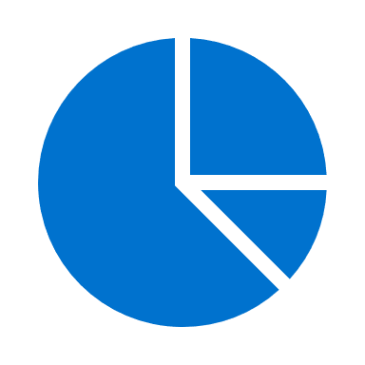
02 Economic Value Generated in the Slovak Republic (continued)
Additional Analyses
The following tables provide an overview of Lidl’s wage costs and taxes paid since the beginning of its operation on the Slovak market, i.e. since 2004. Wage costs have grown every year.
In total, Lidl paid almost EUR 3.3 billion in taxes and EUR 1.3 billion in wages during its operation on the Slovak market**.
Lidl’s total wage costs for 2024 amounted to EUR 168 million.
If the total value generated by Lidl were invested in job creation, almost 41 thousand new jobs would be created in Slovakia.
The nominal volume of Slovak GDP in current prices reached almost EUR 130 billion in 2024. The share of the total value generated by Lidl in Slovak GDP (direct, indirect and induced economic value combined) is 1.6 %.
More than half a million EUR of the purchased electricity represents green electricity.
96% of this green electricity was purchased in Slovakia. For example, the Gabčíkovo Hydropower Plant is among the most important suppliers of green electricity.
Source: Lidl in Slovakia na Slovensku
In this way, Lidl supports the development of alternative sources of electricity in Slovakia, such as hydropower (Cascade of Váh), photovoltaic power plants or solar parks (e.g. Biskupice, Rumince).
* Concessionary fees were not included in the calculation
** 2 989 615 222 EUR

Slide 13
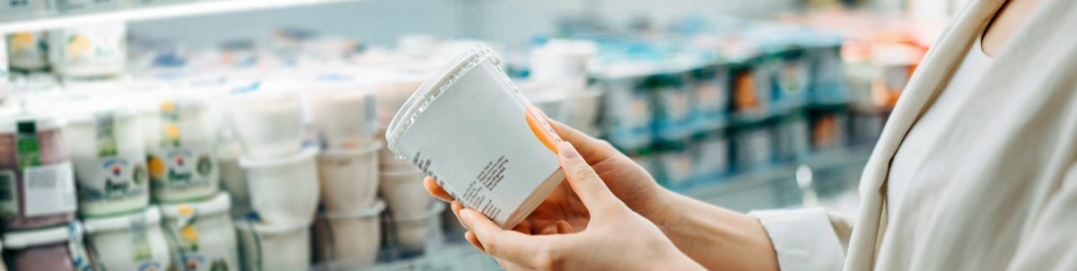
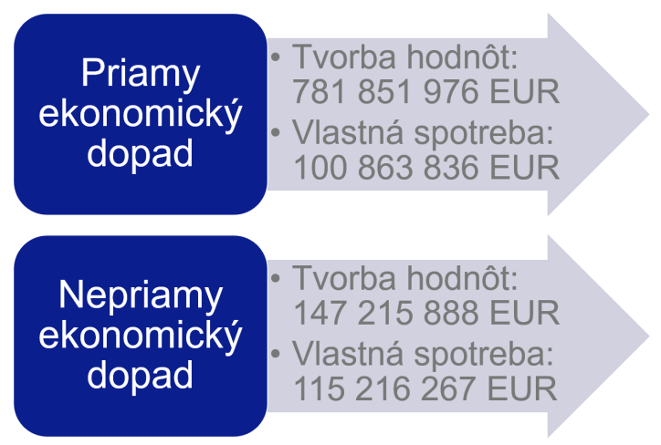
03 Additional Economic Effects
In addition to the direct and indirect economic impacts, Lidl’s operations in the Slovak economy also bring about additional induced effects in the economy.
For the purpose of estimating the induced economic impact, we, similarly, as in the Study of the impact of Lidl Poland on the Polish economy, distinguished between activities that directly contributed to the creation of value for Lidl or stakeholders and activities that represented own consumption (for the purpose of ensuring the functioning of the own organization). The division is as follows:
Value creation:
Purchase intended for the final consumer in Slovakia, VAT paid;
Donations, advertising, circulation, other tax obligations, part of human capital costs*
Own consumption:
Purchase intended for own consumption, export from Slovakia
Part of human capital costs*, energy consumption, building management, legal expenses
All data represent cash flow to Slovak beneficiaries. In 2024, the total value of Slovak products purchased at Lidl was EUR 840,090,048. We consider this amount to be the final output of activities (value creation + own consumption), without which no consumer need satisfaction by Lidl would be possible.
Upon the collected data, we arrived at the following coefficients of the Leontief production function:
To create one unit of direct economic value, 0.24 units of direct economic value and 0.22 units of indirect economic value were required.
To create one unit of indirect economic value, 1.03 units of direct economic value and 0.14 units of indirect economic value were required.
Lidl also purchased products from abroad. These transactions were not included in the direct and indirect economic impacts, since the direct beneficiary was located abroad. However, the processing of these transactions represented an indirect benefit for the Slovak Republic and its economy (it was necessary to process a larger amount of production, which required more Slovak energy, more Slovak time worked, more repairs to movable property in Slovakia due to greater wear and tear).
Direct economic impact
Value creation:
Own consumption:
Indirect economic impact
Value creation:
Own consumption:
* Transfer between Indirect Economic Impact categories was 50 million EUR

Slide 14
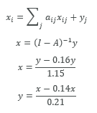
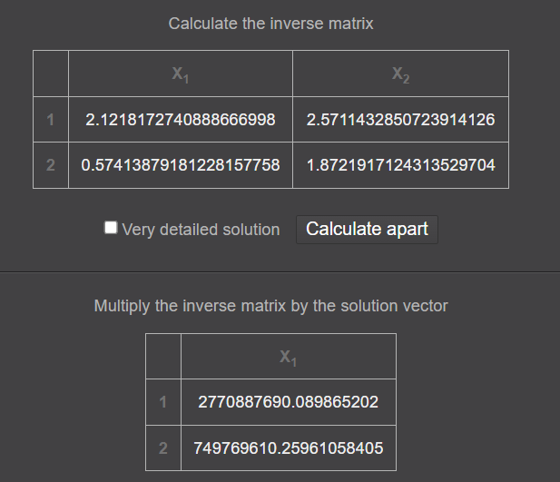

03 Additional Economic Effects (continued)
The value of products sold from abroad in 2024 amounted to EUR 1,305,903,069. We applied the following relationships:
After substituting the coefficients into the matrix, we arrived at an indirect economic value of EUR 749,769,610. The calculation was performed using the matrix calculator:
To satisfy the demand for goods from abroad, EUR 749,769,610 of indirect economic value is needed. We do not take the need for direct value into account, as it represents a purchase abroad, which is irrelevant for the creation of value in Slovakia.
Interpretation of the Results from the Application of the Leontief Production Function
The amount of EUR 749,769,610 includes all subcategories of indirect economic impact. In the Study, we do not further divide this amount into individual subcategories, because this would be another expert estimate and, in our opinion, the benefit of the information obtained would not exceed the increased level of uncertainty. The amount represents the induced economic value beyond the direct and indirect value distributed by Lidl. The value was induced by the provision of foreign products and the impact of these activities/processes on the Slovak beneficiaries (e.g. the need for additional hours worked, the need for additional energy consumption, etc.). The amount of EUR 749,769,610 represents our expert estimate using the relationships known from the Leontief production function.
Every 1 euro of Lidl’s distributed economic value in Slovakia has the potential to generate additional 58 cents for Slovak beneficiaries (communities, private sector, cities and the state).
The total economic value generated by Lidl’s activities and presence in the Slovak economy in 2024 exceeded 2 billion EUR.
For the total economic value created by Lidl in the Slovak economy in 2024, it would be possible to completely reconstruct 13 train stations similar to the Main Station in Bratislava.
Direct economic impact | €973,526,856
Indirect economic impact | €315,205,737
Induced economic impact | €749,769,610
Total economic value | €2,038,502,203

Slide 15
Contact
Follow us
SKY PARK OFFICES 1
Bottova 2A
811 09 Bratislava
Branch offices: Bratislava, Košice, Nitra, Považská Bystrica
Study Co-Authors
Martin Dolinský
Sustainability Manager
Forvis Mazars
martin.dolinsky@forvismazars.com
Martin Palider
Sustainability Consultant
Forvis Mazars
martin.palider@forvismazars.com
LinkedIn:
https://www.linkedin.com/company/forvis-mazars-group
Facebook: https://www.facebook.com/forvismazarsinslovakia
Instagram: https://www.instagram.com/forvismazarsinslovakia/
Forvis Mazars Group SC is indeed an independent member of the Forvis Mazars Global network, which is a leading international professional advisory services network. This network specializes in audit, tax, and advisory services, operating as an integrated partnership across more than 100 countries and territories. To help clients of all sizes at every stage of their development, the company combines the expertise and cultural understanding of more than 40,000 professionals worldwide.
Forvis Mazars in Slovakia is part of Forvis Mazars Group SC.
For more information, please visit our website: www.forvismazars.com/sk
© Forvis Mazars 2025

